Slide 2
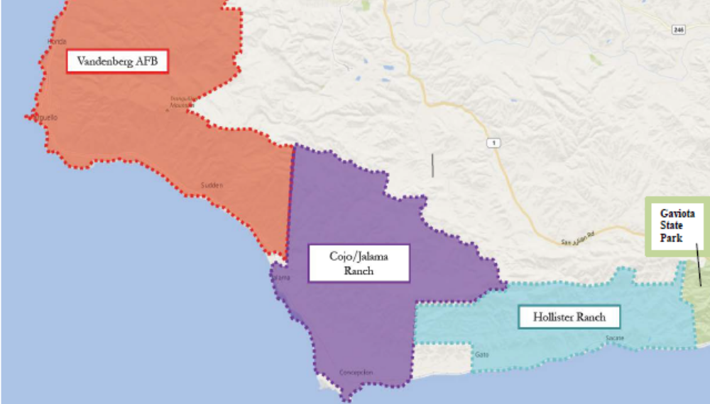
Exhibit 1
Item F 5 Hollister Ranch settlement agreement
Exhibit 1
Item F 5
Hollister Ranch Settlement Agreement
1 of 1

Slide 3
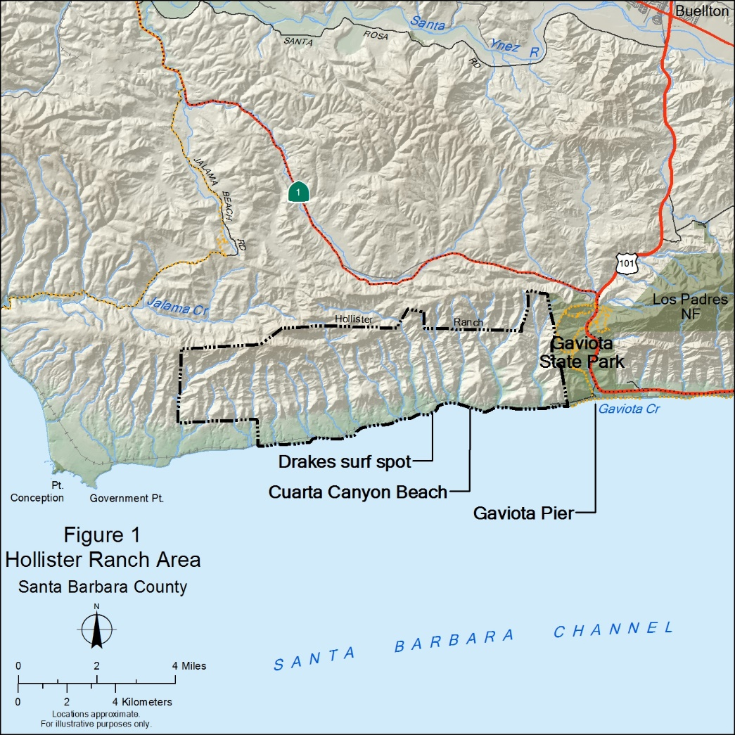
Exhibit 2
Item F 5
Hollister Ranch Settlement Agreement
1 of 1

Slide 4
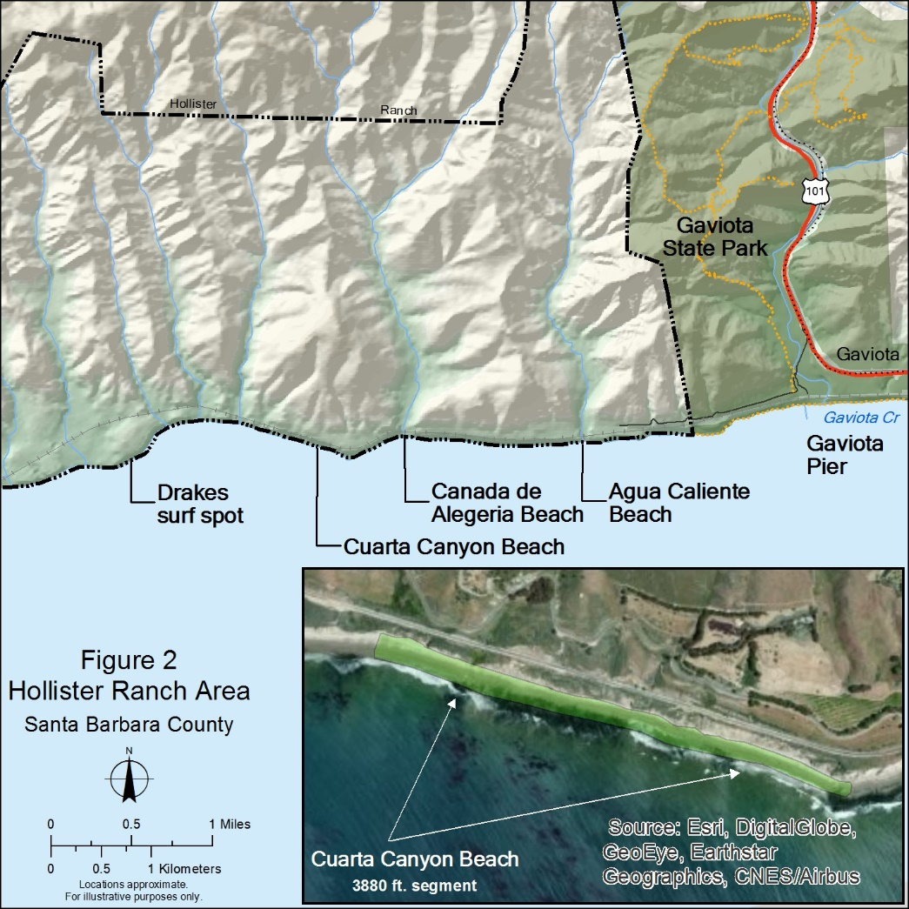
Exhibit 3
Item F 5
Hollister Ranch Settlement Agreement
1 of 1

Slide 5
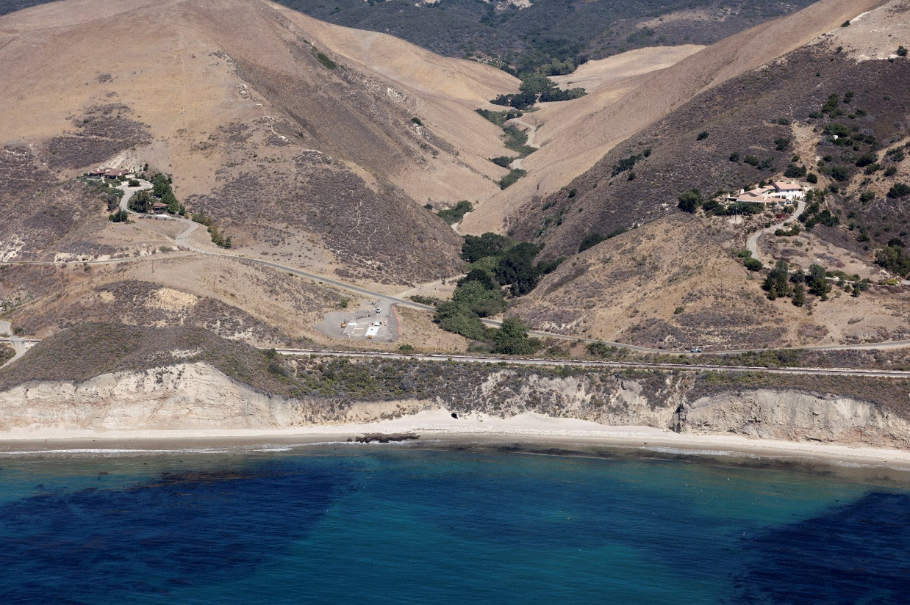
Cuarta Canyon Creek
Tunnel
Cuarta Canyon Beach easement
3880 linear ft
Exhibit 4
Item 5 F
Hollister Ranch Settlement Agreement
1 of 1

Slide 6
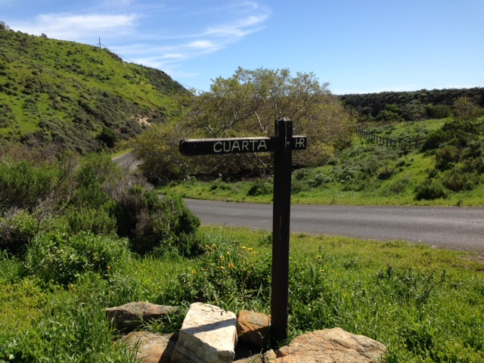
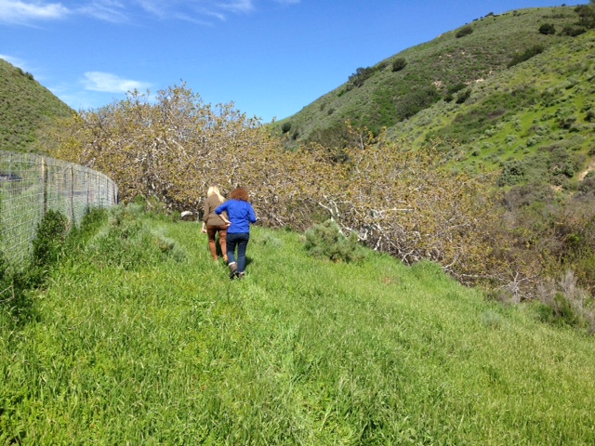
Ranch Road at Cuarta Canyon
Beach Easement along Cuarta Canyon
Exhibit 5
Item F 5
Hollister Ranch Settlement Agreement
1 of 4

Slide 7
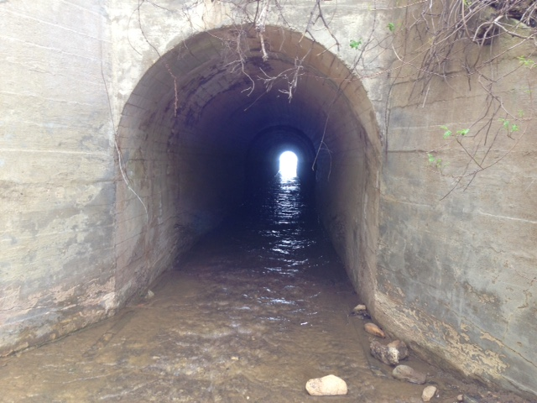
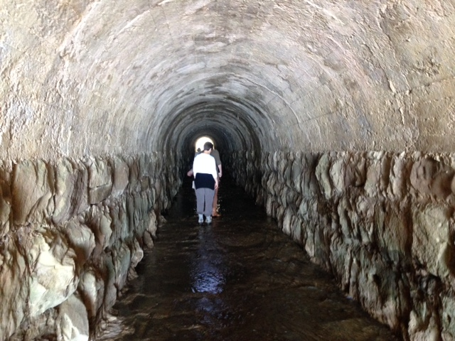
Tunnel Entrance
Entrance to tunnel
Inside tunnel
Inside Tunnel
Exhibit 5
Item 5 F
Hollister Ranch Settlement Agreement
2 of 4

Slide 8
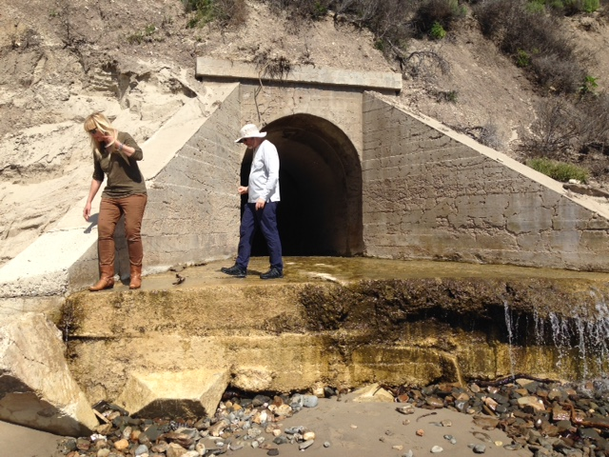
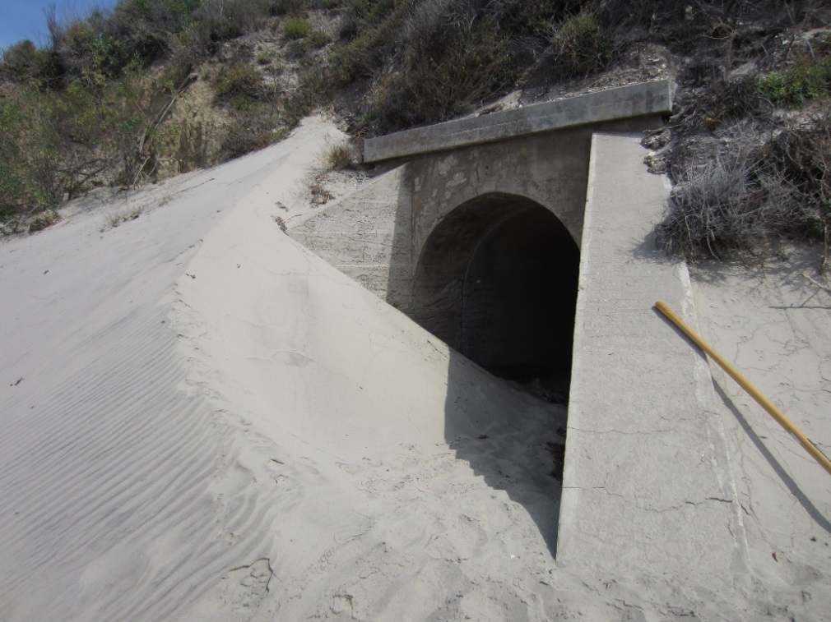
Exit from tunnel to beach
Low sand level
High sand level
Exhibit 5
Item F 5
Hollister Ranch Settlement Agreement
3 of 4

Slide 9
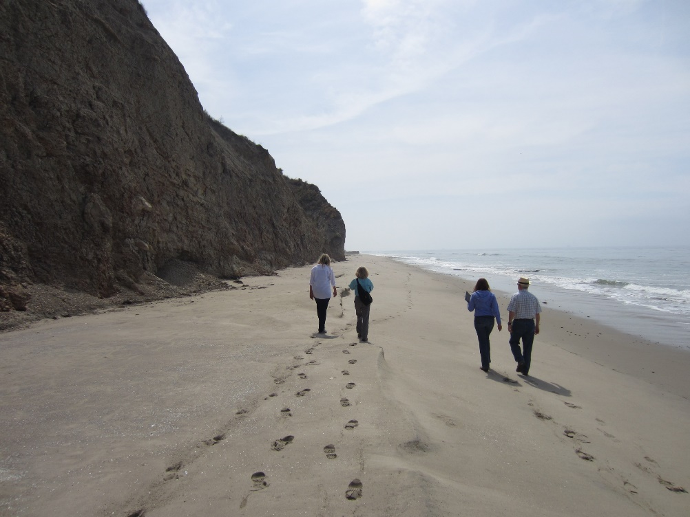
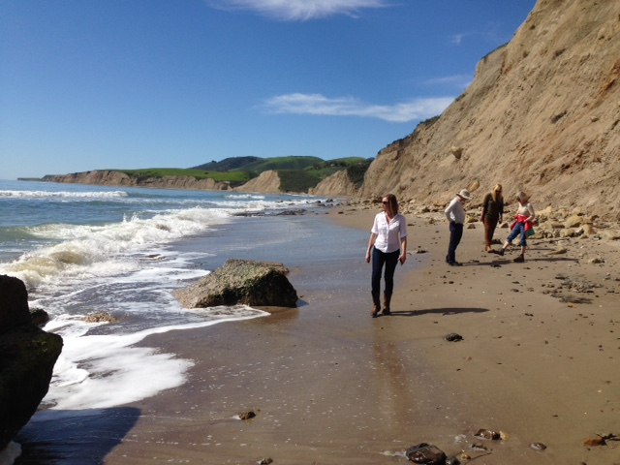
101 Total Planning Items
Western end of Cuarta Canyon Beach – Easement is 3880 ft long
Beach down coast of the tunnel showing seasonal beach width and profile differences.
Exhibit 5
Item F 5
Hollister Ranch Settlement Agreement
4 of 4

